Slide 1
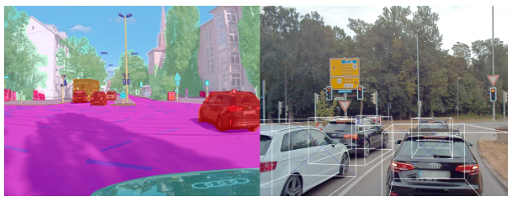
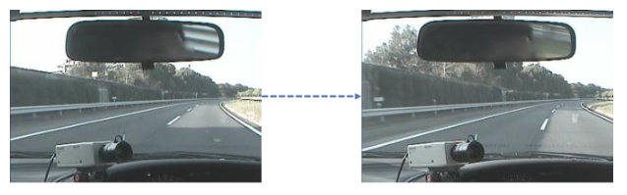
Study of Vehicle Lane changing behavior on Audi dataset using deep neural network
COMP 5530 – Deep learning
Aman Kumar
Source : https://en.wikipedia.org/wiki/Electric_machine
Notes:
BEHLOL

Slide 2
Semantic segmentation model study for cityscape dataset
COMP 5530 – Deep learning
Aman Kumar
Source : https://en.wikipedia.org/wiki/Electric_machine
Notes:
BEHLOL

Slide 3
Outline
Introduction
Dataset
Approach
Models' Training
Results
Conclusion
Notes:
BEHLOL

Slide 4
Introduction and Problem statement
Image
Semantic segmentation
Object detection and lane detection
Lane Changing
Advanced Driver assistance system can help in preventing road accident. Assistance can help us to prevent road accident.
Notes:
BEHLOL

Slide 5
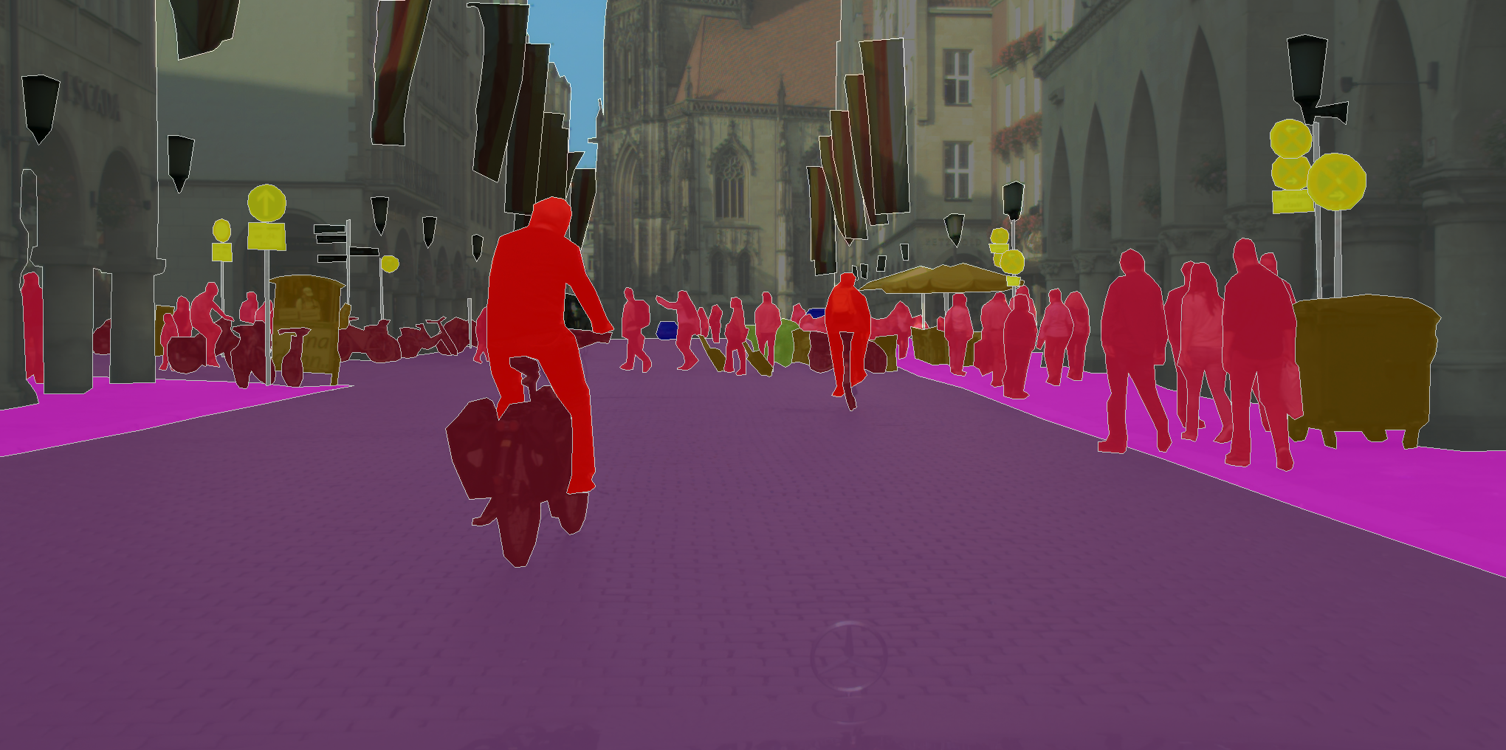
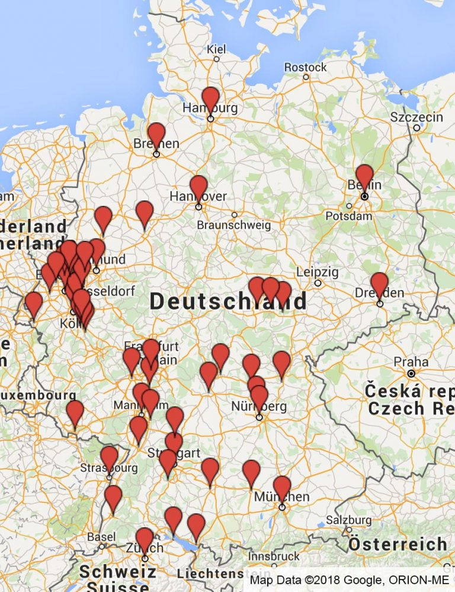
Cityscapes dataset Semantic Understanding of Urban Street Scenes
Group | Classes
flat | road · sidewalk · parking⁺ · rail track⁺
human | person* · rider*
vehicle | car* · truck* · bus* · on rails* · motorcycle* · bicycle* · caravan^{*+} · trailer^{*+}
construction | building · wall · fence · guard rail⁺ · bridge⁺ · tunnel⁺
object | pole · pole group⁺ · traffic sign · traffic light
nature | vegetation · terrain
sky | sky
void | ground⁺ · dynamic⁺ · static
Instance segmentation for vehicle and people
30 classes
Diversity - 50 cities, Several months (spring, summer, fall), Daytime, Good/medium weather conditions
5 000 annotated images with fine annotations Benchmark suite and evaluation server
Pixel-level semantic labeling
Instance-level semantic labeling
Notes:
BEHLOL

Slide 6
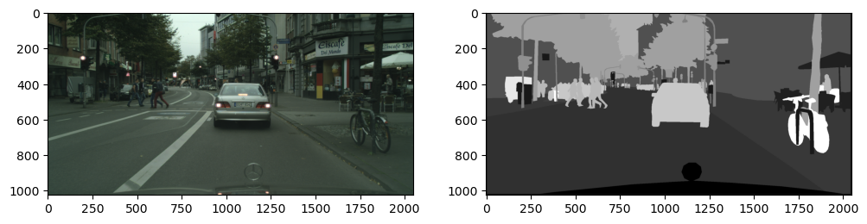
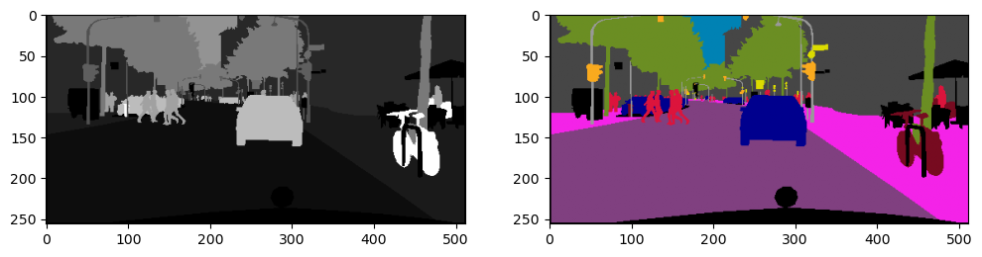
Dataset – Train / testing
~5000 images of 18 cities
Fine semantic in gray scale
Coloring the images as per class defined
Image
Semantic Image (target)
Coloring as per class / label (target-multi class)
Notes:
BEHLOL

Slide 7
Approach
Compare the performance of suitable algorithms for classification:
Segmentation model is just a PyTorch nn.Module, imported as segmentation_models_pytorch
Model architectures – Unet , PSPnet, DeeplabV3
Encoders – Resent18, Resent34, Resent50, Resent101, Resent152, VGG19, mobilenet
Pretrained weights - imagenet
Notes:
BEHLOL

Slide 8
Approach
Compare the performance of suitable algorithms for classification:
Segmentation model is just a PyTorch nn.Module, imported as segmentation_models_pytorch
Model architectures – Unet , PSPnet, DeeplabV3
Encoders – Resent18, Resent34, Resent50, Resent101, Resent152, VGG19, mobilenet
Pretrained weights - imagenet
Notes:
BEHLOL

Slide 9
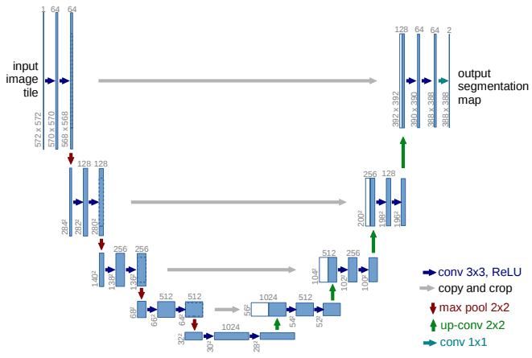
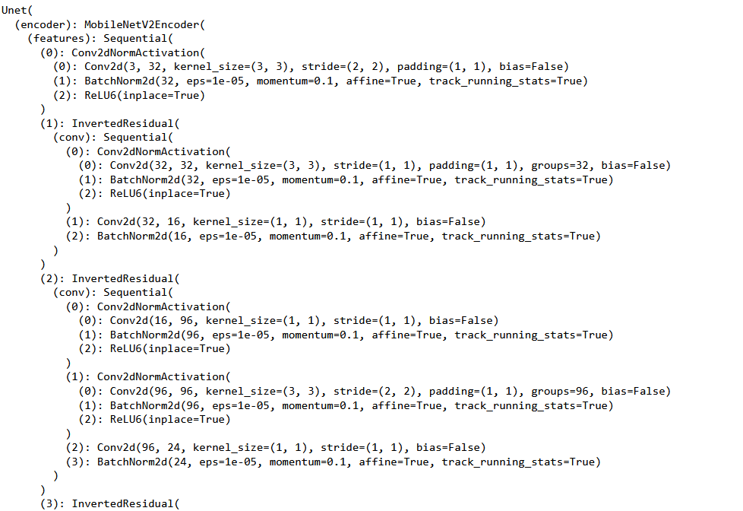
UNET- Model Architecture
Notes:
TRAVIS

Slide 10
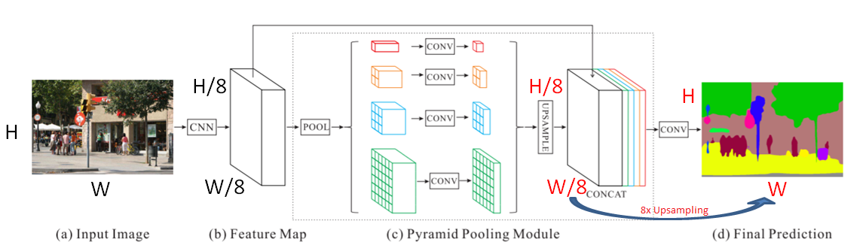
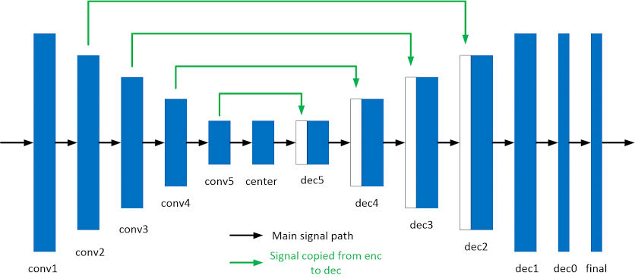
PSPNet (Pyramid scene parsing network)- Model Architecture
Notes:
TRAVIS

Slide 11
Encoder and pretrained weights
encoder_name – Name of the classification model that will be used as an encoder (a.k.a backbone) to extract features of different spatial resolution
encoder_depth – A number of stages used in encoder in range [3, 5]. Each stage generate features two times smaller in spatial dimensions than previous one (e.g. for depth 0 we will have features with shapes [(N, C, H, W),], for depth 1 - [(N, C, H, W), (N, C, H // 2, W // 2)] and so on). Default is 5
encoder_weights – One of None (random initialization), “imagenet” (pre-training on ImageNet) and other pretrained weights

Slide 12
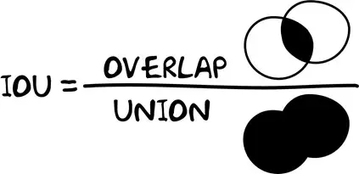
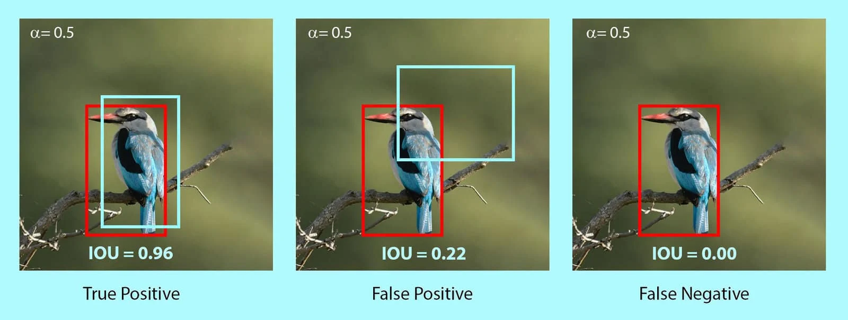
Training
50 epoch on CUP only with 16 cores
8-12 hours training time for 50 epoch
AdamW Optimizer, learning rate = 1e-3
Dice Loss criteria on multiclass mode for loss function ( lower value is good)
Jaccard Index for n_classes (20) as loss IoU intersection over union metric. ( Higher value is good).

Slide 13
Results : Testing – on training dataset
Architecture | Encoder | pretrained weight | Loss | IoU
Unet | ResNet18 | Imagenet | 0.478 | 0.413
Unet | ResNet34 | Imagenet | 0.773 | 0.162
Unet | ResNet101 | Imagenet | 0.684 | 0.224
Unet | ResNet152 | Imagenet | 0.948 | 0.014
Unet | MobileNet | Imagenet | 0.478 | 0.413
Unet | VGG19 | Imagenet | 0.955 | 0.011
DeepLabV3 | ResNext50 | Imagenet | 0.962 | 0.023
PSP Net | ResNet 34 | Imagenet | 0.741 | 0.208

Slide 14
Results : Testing – on training dataset

Slide 15
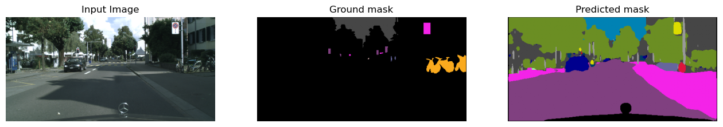
Results – Best CASE
Unet + MobileNet: Loss-0.436; IoU- 0.419
Unet + Resnet18: Loss-0.478; IoU- 0.412

Slide 16
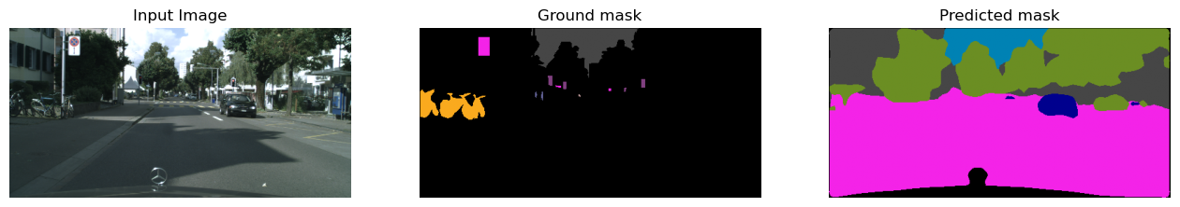
Results – AVERAGE case
PSP Net: Loss-0.74; IoU- 0.2

Slide 17
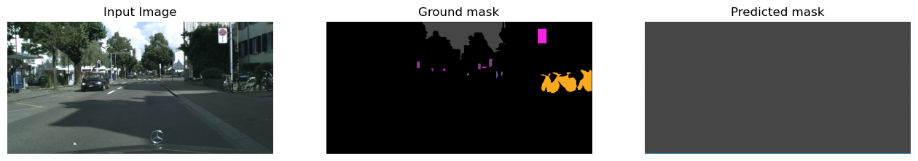
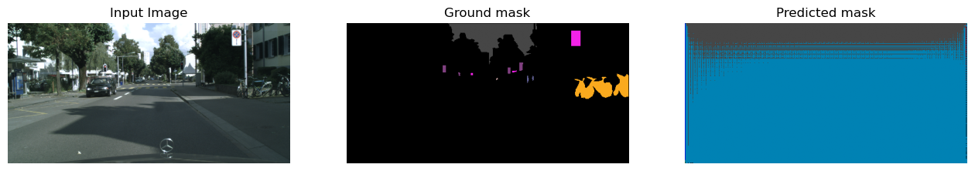
Results – Failed CASES
Unet + VGG19: Loss-0.955; IoU- 0.011
Unet + Resnet152 : Loss-0.931; IoU- 0.011

Slide 18
Reference
M. Cordts, M. Omran, S. Ramos, T. Rehfeld, M. Enzweiler, R. Benenson, U. Franke, S. Roth, and B. Schiele, “The Cityscapes Dataset for Semantic Urban Scene Understanding,” in Proc. of the IEEE Conference on Computer Vision and Pattern Recognition (CVPR), 2016. URL https://arxiv.org/abs/1604.01685
M. Cordts, M. Omran, S. Ramos, T. Scharwächter, M. Enzweiler, R. Benenson, U. Franke, S. Roth, and B. Schiele, “The Cityscapes Dataset,” in CVPR Workshop on The Future of Datasets in Vision, 2015. URL - https://www.cityscapes-dataset.com/wordpress/wp-content/papercite-data/pdf/cordts2015cvprw.pdf
Segmentation Models - https://smp.readthedocs.io/en/latest/models.html

